Slide 1
Matrix Multiplication with Photonic Simulation
Team: A1_14

Slide 2
Goals for Sprint 3
Simulate a simple photonic integrated circuit with Simphony
Simulate same circuit with Noxim
Compare results
Decide if continuing with both simulation softwares or just one
Create shared project folder on SCC
Successfully run chosen simulation software in SCC

Slide 3
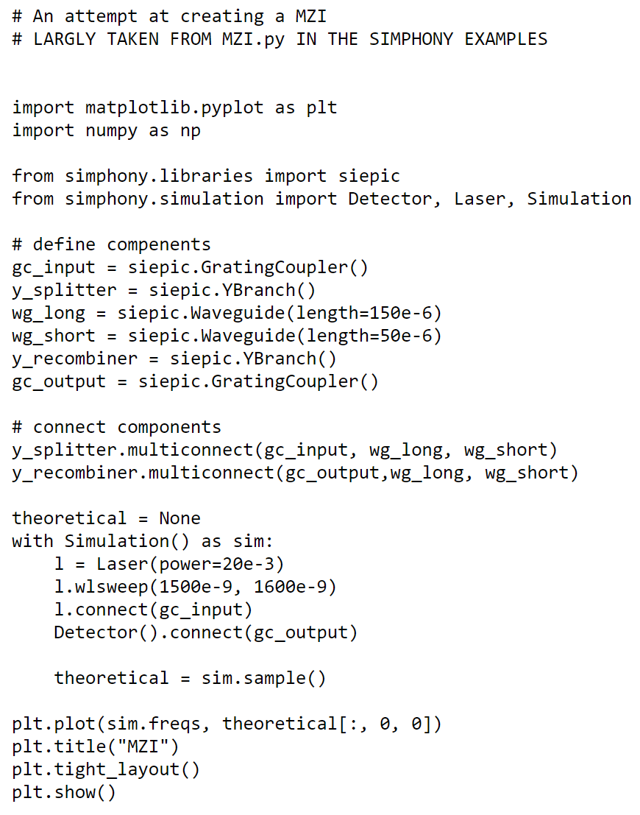
What Went Well
Created shared project folder on SCC
Confirmed Simphony is available on SCC and works
Creation of simple PIC using Simphony

Slide 4
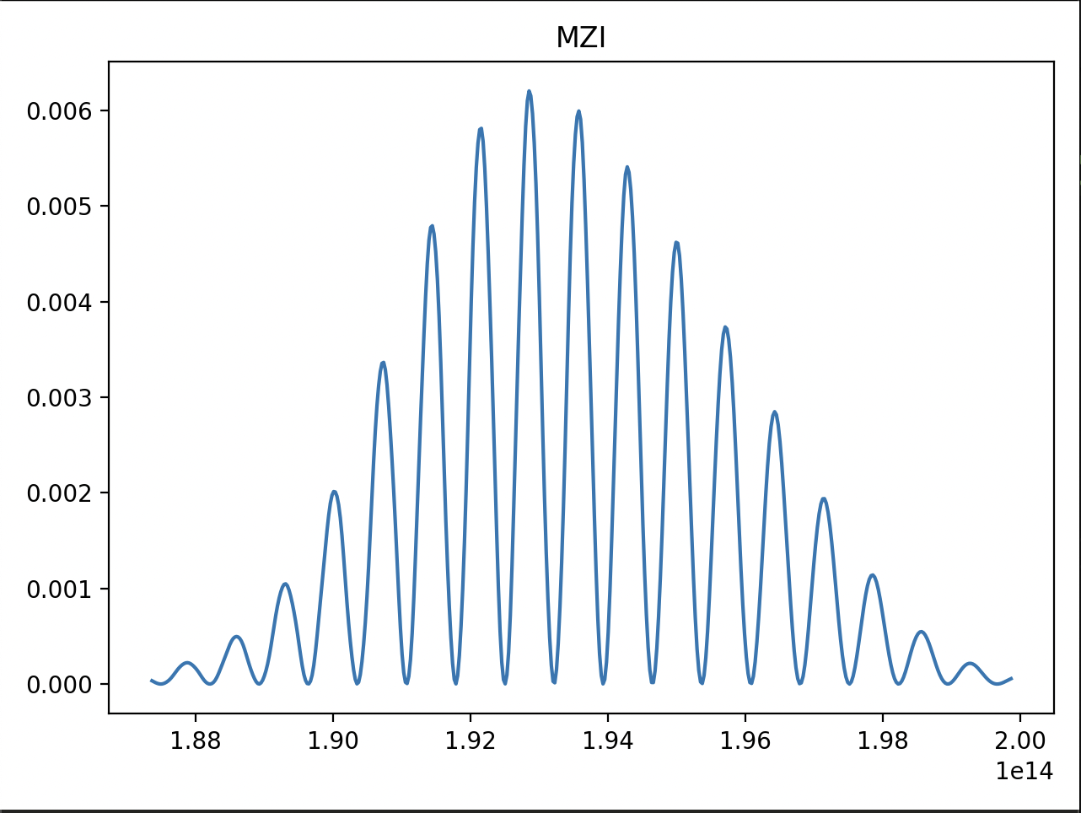
Simphony Results
Graph shows the resulting Frequency (Y-Axis) of a Wavelength Sweep put in input of MZI.
Input Beam is Split and undergoes different phase shifts and then interferes when merges back together.
MZI is building block of the Matrix Multiplier.

Slide 5
What Went Not So Well
Noxim not as intuitive to use as Simphony
Have to read through code and use trial-and-error to figure things out
Limited troubleshooting
Not all versions of Simphony are fully compatible with each other

Slide 6
Goals for Sprint 4
Simulate a matrix multiplication of a 2x2 matrix
Compare results of Noxim and Simphony circuits
Finalize which version of Simphony to use
Successfully run chosen simulation software in SCC
Merge results to Github more often
Check in with other teammates more often on progress

